Slide 1

Sprocket Central Pty Ltd
Data analytics approach

Slide 2
Agenda
Introduction
Data Exploration
Model Development
Interpretation

Slide 3
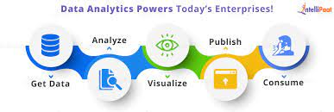
Introduction
Data insights refers to the deep understanding an individual or organization gains from analyzing information on a particular issue. This deep understanding helps organizations make better decisions than by relying on gut instinct.
Place any supporting images, graphs, data or extra text here.

Slide 4
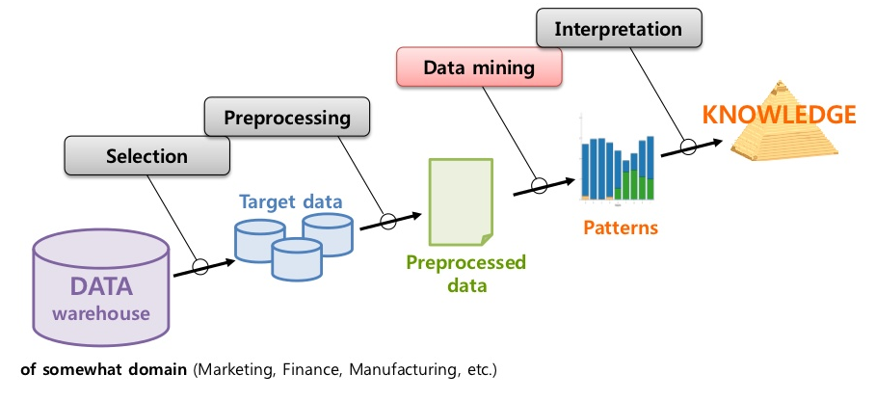
Data Exploration
Data exploration: Data exploration refers to the initial step in data analysis in which data analysts use data visualization and statistical techniques to describe dataset characterizations, such as size, quantity, and accuracy, in order to better understand the nature of the data.

Slide 5
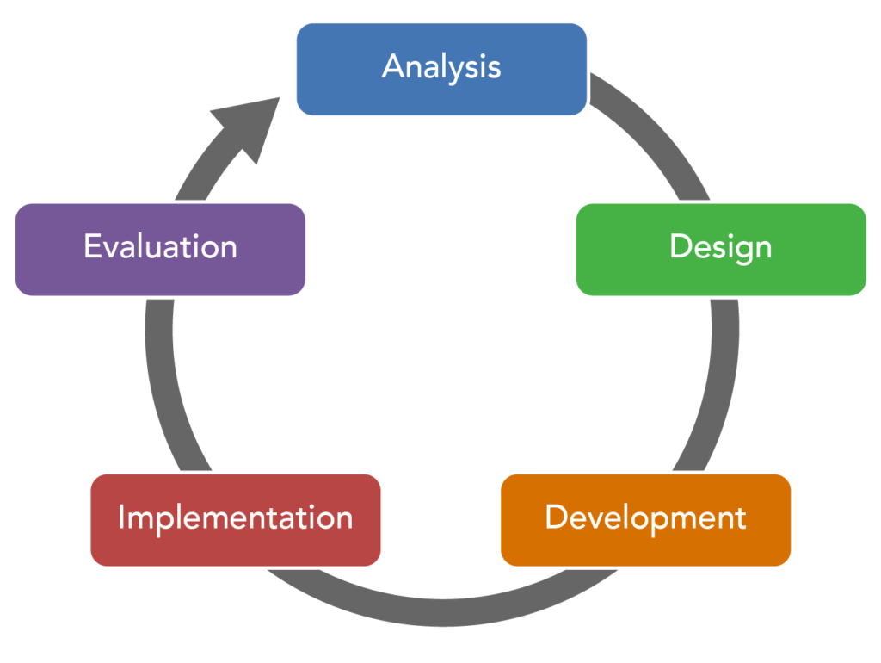
Model Development
Model development is an iterative process, in which many models are derived, tested and built upon until a model fitting the desired criteria is built. Subsequent modelling work may need to begin the search at the same place as the original model building began, rather than where it finished.

Slide 6
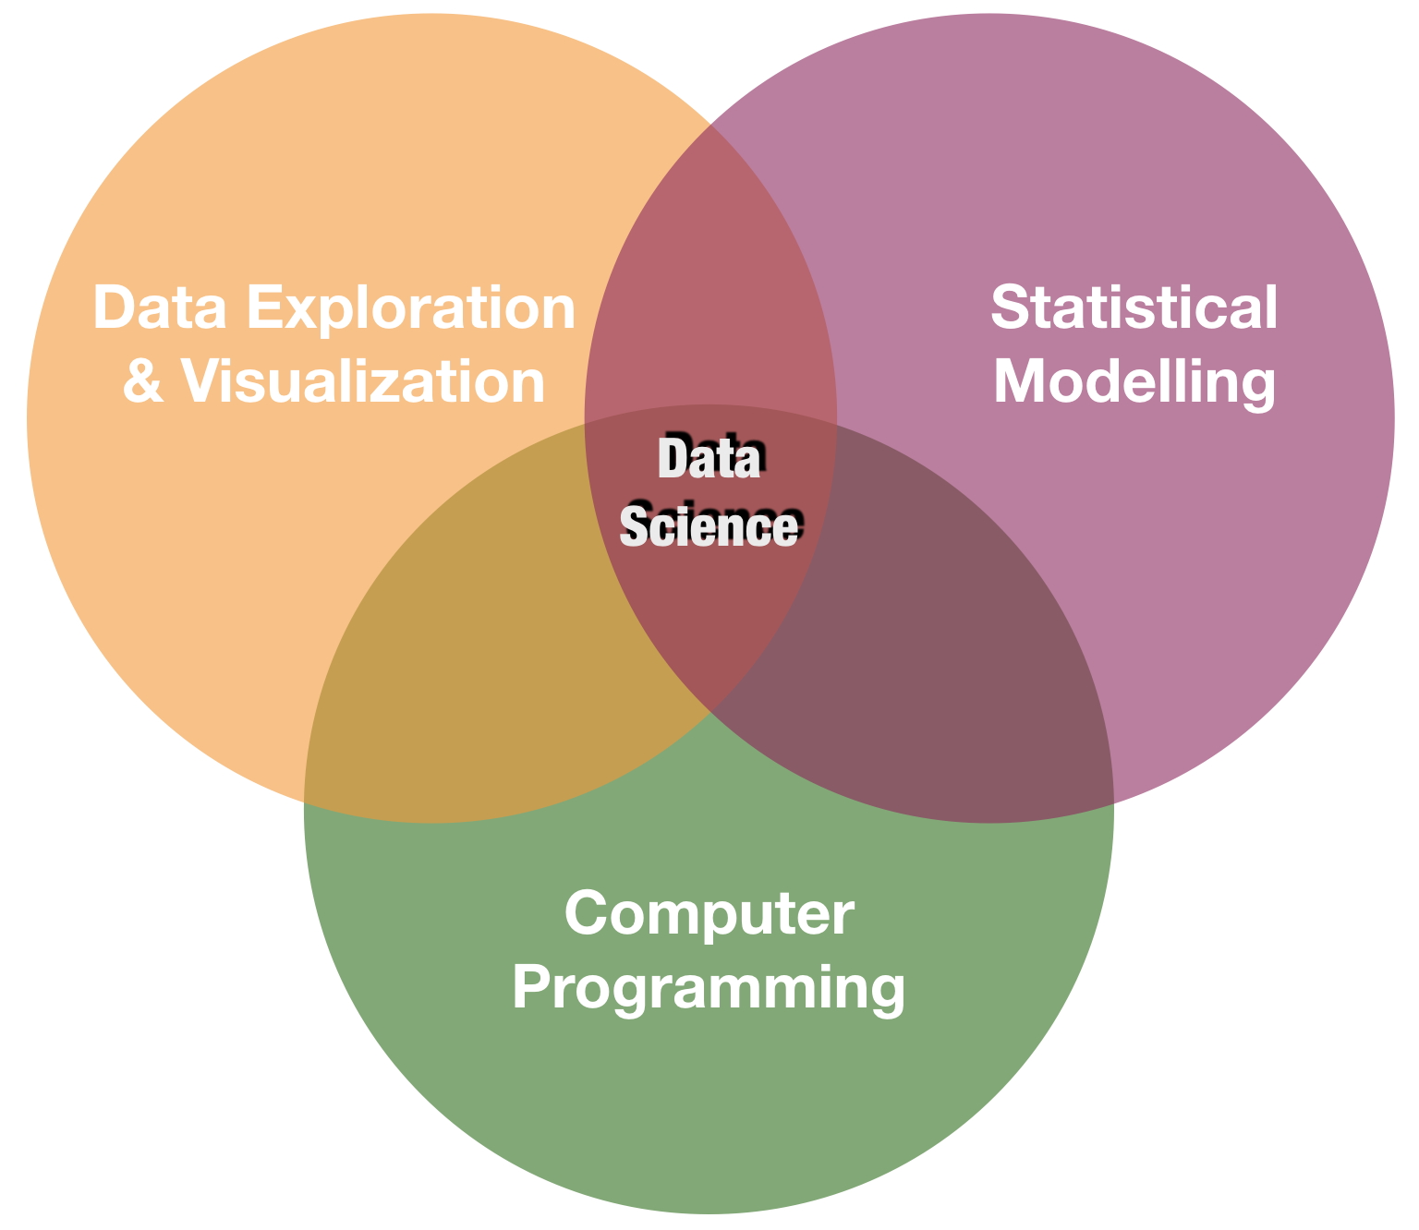
Interpretation
Data interpretation is the process of reviewing data and arriving at relevant conclusions using various analytical research methods. Data analysis assists researchers in categorizing, manipulating, and summarizing data to answer critical questions.

